Slide 1
Perceptron and Perceptron Training
Dr. Sifat Momen

Slide 2
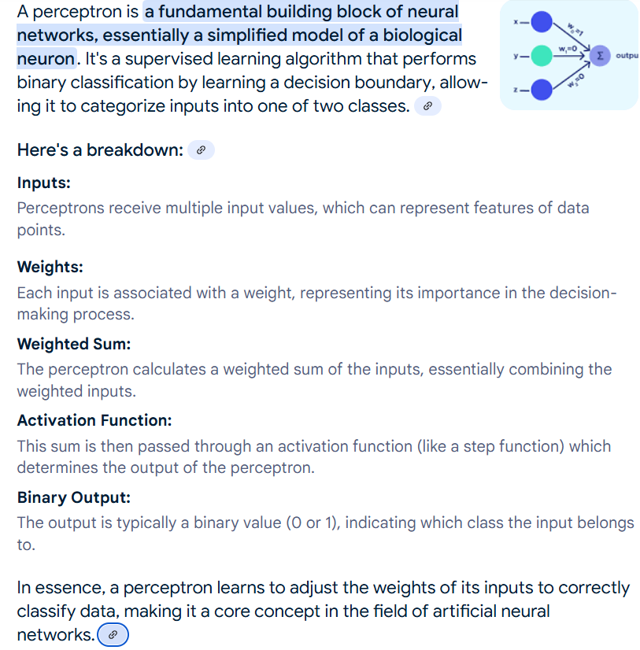

Slide 3
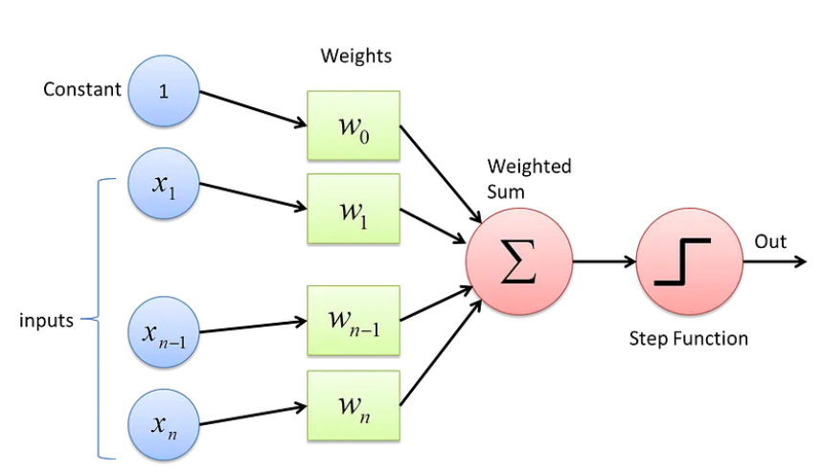
Linear Perceptron Architecture

Slide 4
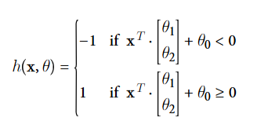
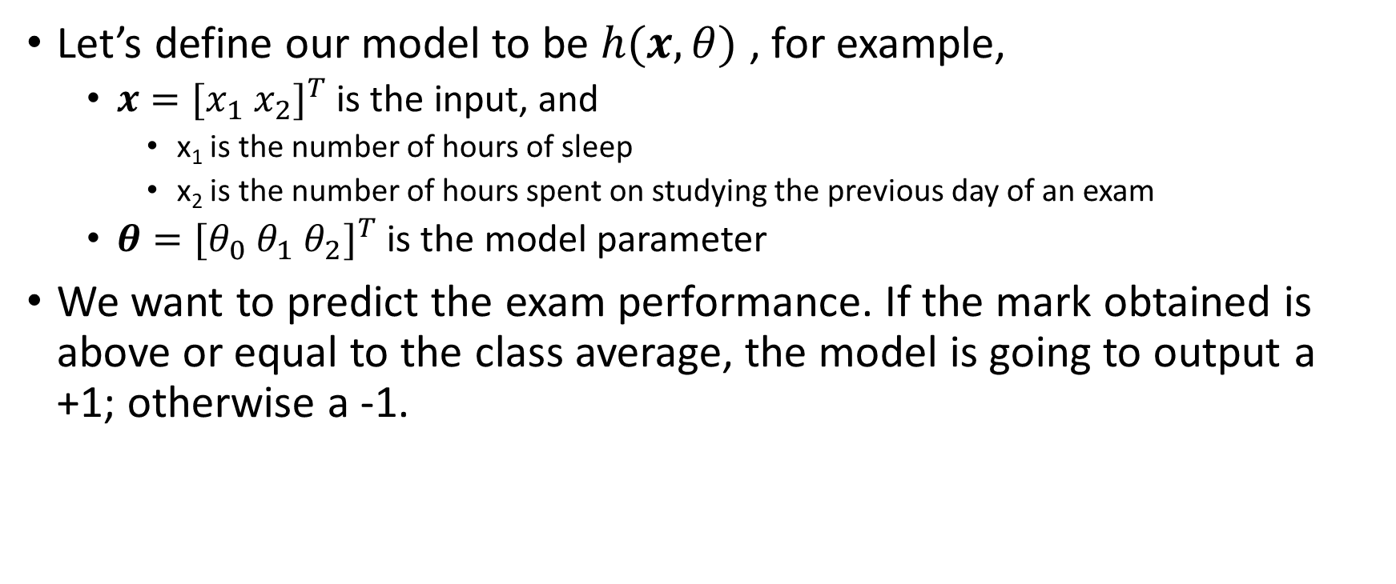
Linear Perceptron
Let’s define our model to be $h(x, θ)$ , for example,
$x=[x_{1} x_{2}]^{T}$ is the input, and
x₁ is the number of hours of sleep
x₂ is the number of hours spent on studying the previous day of an exam
$θ=[θ_{0} θ_{1} θ_{2}]^{T}$ is the model parameter
We want to predict the exam performance. If the mark obtained is above or equal to the class average, the model is going to output a +1; otherwise a -1.

Slide 5

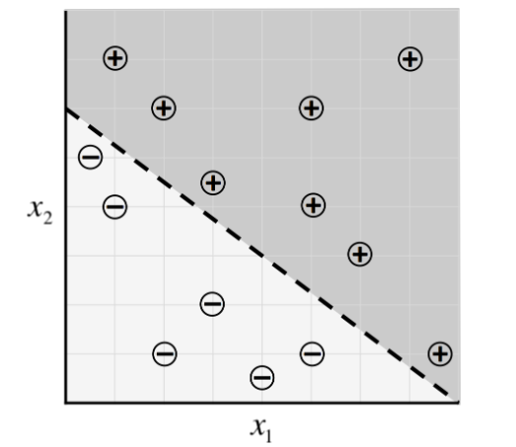
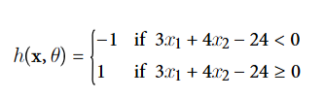
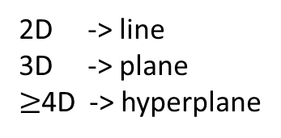
Linear Perceptron
2D -> line
3D -> plane
$≥$4D -> hyperplane

Slide 6
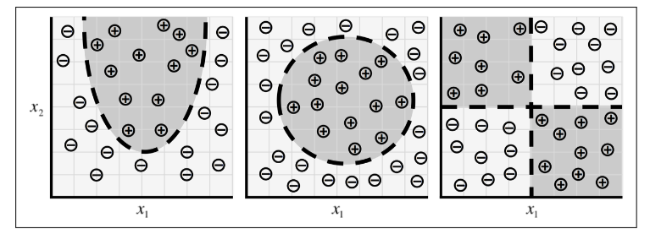
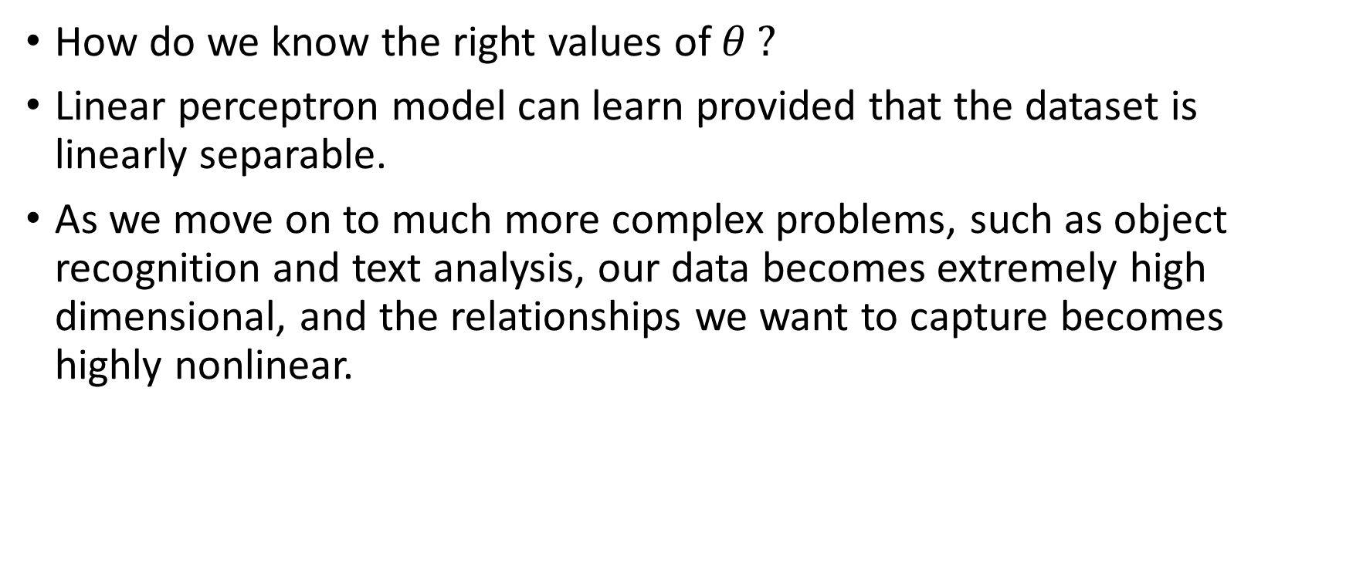
Issues
How do we know the right values of $θ ?$
Linear perceptron model can learn provided that the dataset is linearly separable.
As we move on to much more complex problems, such as object recognition and text analysis, our data becomes extremely high dimensional, and the relationships we want to capture becomes highly nonlinear.

Slide 7
Neuron
Foundational unit of a human brain is a neuron.
A tiny piece of a brain, about the size of grain of rice, contains over 10,000 neurons, each of which forms an average of 6,000 connections with other neurons.
It’s this massive biological network that enables us to experience the world around us.

Slide 8
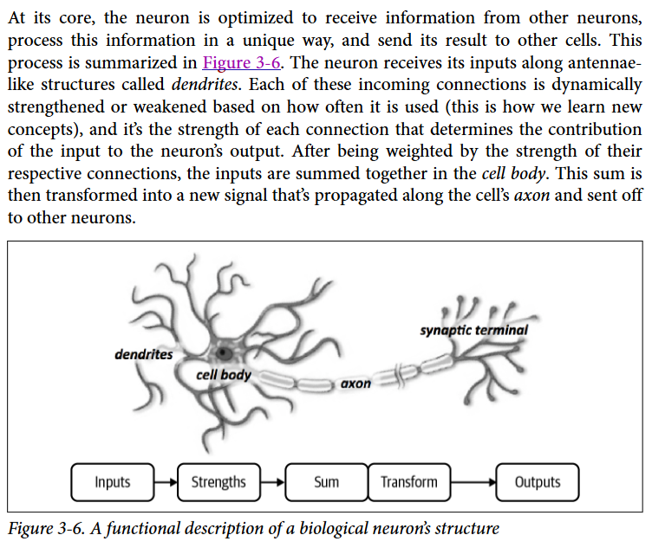
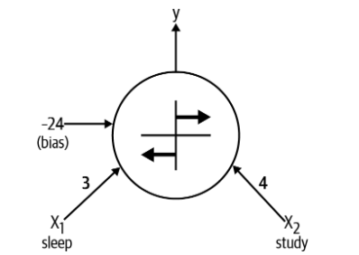


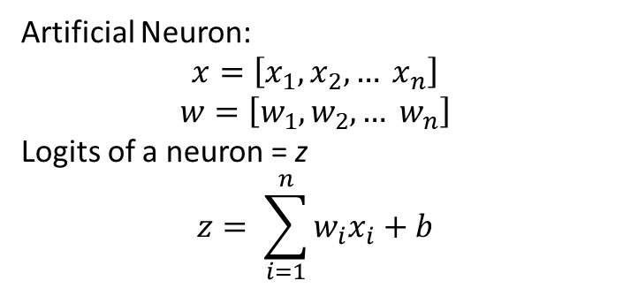
Expressing linear perceptron as neurons
Artificial Neuron:
$$x=\left[x_{1}, x_{2}, … x_{n}\right]$$
$$w=\left[w_{1}, w_{2}, … w_{n}\right]$$
Logits of a neuron = z
$$z= \sum_{i=1}^{n}{w_{i}x_{i}+b}$$

Slide 9
Feed-forward neural networks
A single neuron is not expressive enough to solve complicated learning problems.
That’s the reason, our brain is made of more than one neuron.
In fact, the neurons in our brain are organized in layers.
The human cerebral cortex (the structure responsible for most of the human intelligence) is made up of 6 layers.
Information flows from one layer to another until sensory input is converted into conceptual understanding.

Slide 10
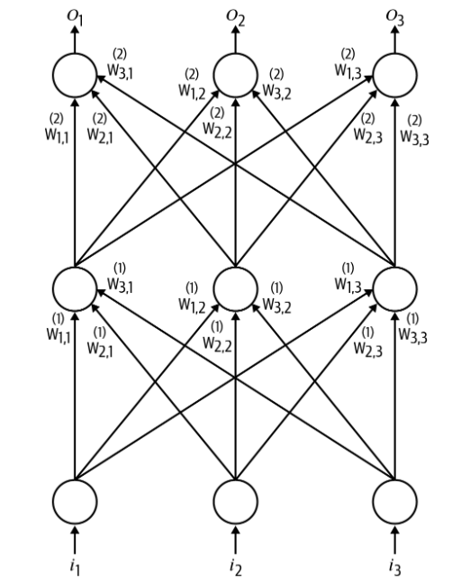
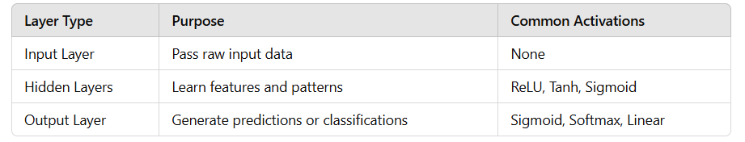
Feed-forward neural network
Input Layer:
Introduces raw input data into the network
Each neuron in this layer corresponds to one feature of the input data.
The input layer does not perform any computation; it simply passes the data to the next layer.
Hidden Layer:
Hidden layers are where the majority of the learning happens.
Output Layer:
Produces the final output of the network, which can be:
A single value (e.g., regression).
Class probabilities (e.g., classification).

Slide 11
Linear Neurons and their limitations
Linear neurons are easy to compute with, but they run into serious limitations.
Infact, it can be shown that any feed-forward neural network consisting of only linear neurons can be expressed as a network with no hidden layers.
This is problematic because, as we discussed, hidden layers are what enable us to learn important features from the input data. In other words, to learn complex relationships, we need to use neurons that employ some sort of nonlinearity.
1
b = 1
x₂
w₂ = 4
Σ
A
w₁ = 2
x₁

Slide 12

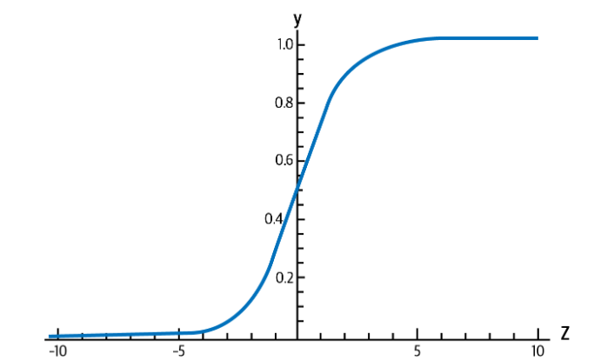
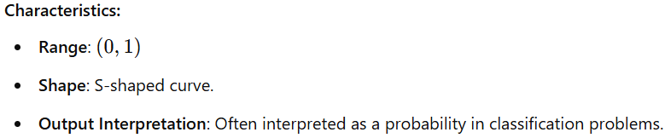
Sigmoid, Tanh, and ReLU Neurons
They introduce nonlinearities in their computations.
These neurons use different activation functions on the logits.
Sigmoid function

Slide 13

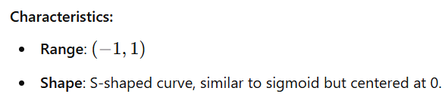
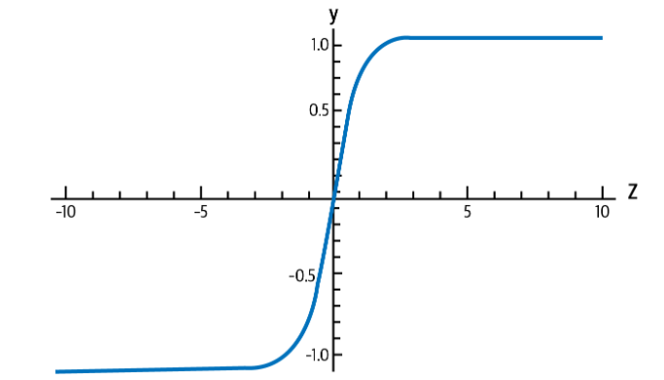
Tanh Neurons
These neurons apply tanh (hyperbolic tangent) functions as activation functions

Slide 14

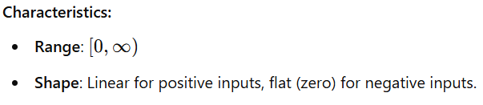
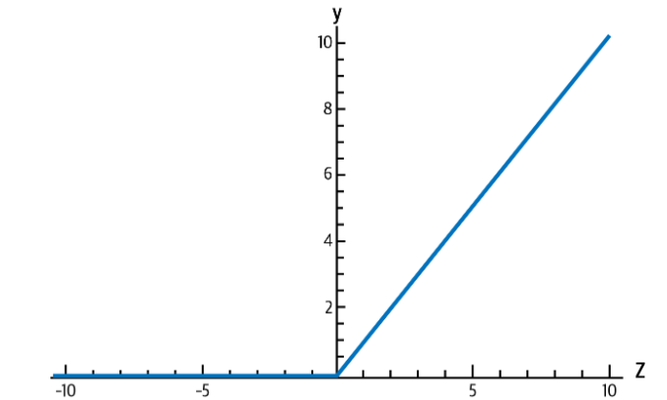
ReLU Neurons
They apply ReLU functions as activation functions.

Slide 15

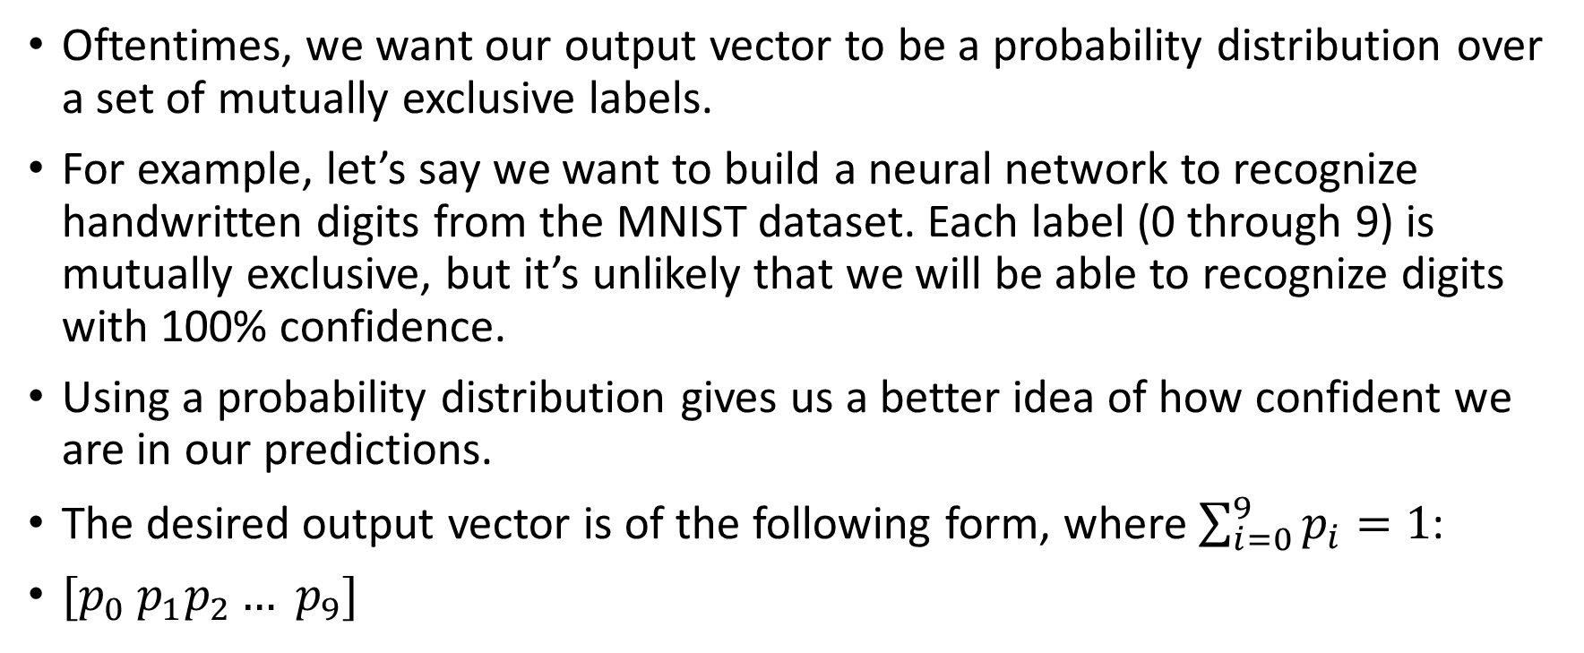
Softmax Output layer
Oftentimes, we want our output vector to be a probability distribution over a set of mutually exclusive labels.
For example, let’s say we want to build a neural network to recognize handwritten digits from the MNIST dataset. Each label (0 through 9) is mutually exclusive, but it’s unlikely that we will be able to recognize digits with 100% confidence.
Using a probability distribution gives us a better idea of how confident we are in our predictions.
The desired output vector is of the following form, where $\sum_{i=0}^{9}{p_{i}=1}$:
$[p_{0} p_{1}p_{2}… p_{9}]$

Slide 16
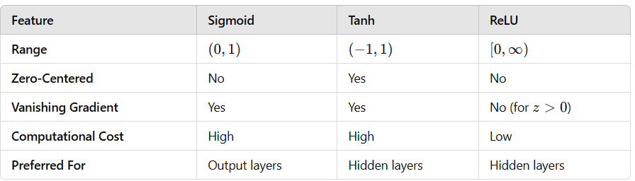
Comparison of Sigmoid Tanh, and ReLU

Slide 17
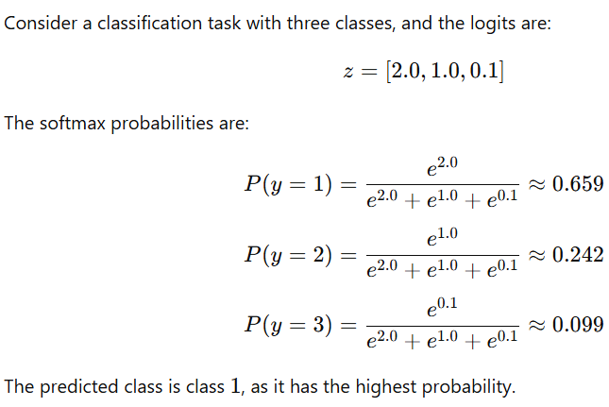
Example of Softmax function

Slide 18
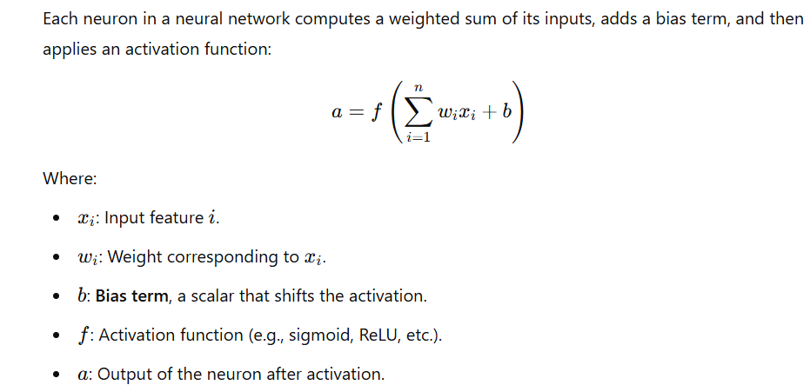
Role of Bias in a neural network

Slide 19
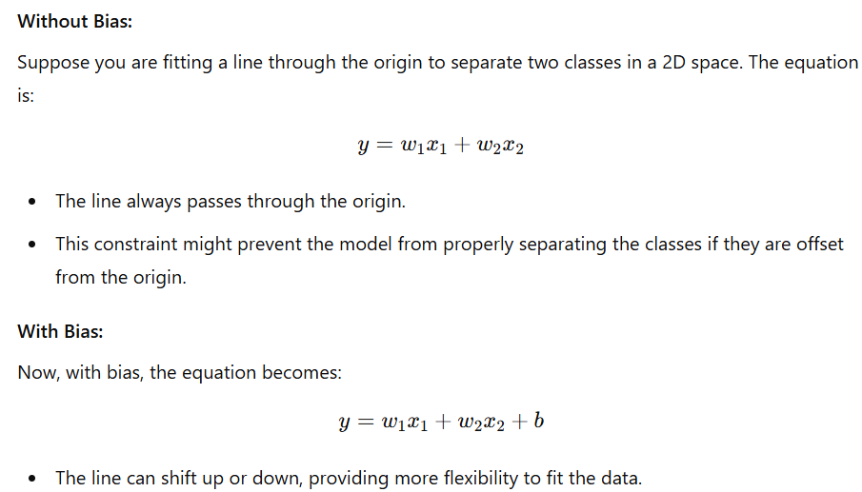
Example of Bias in action

Slide 20
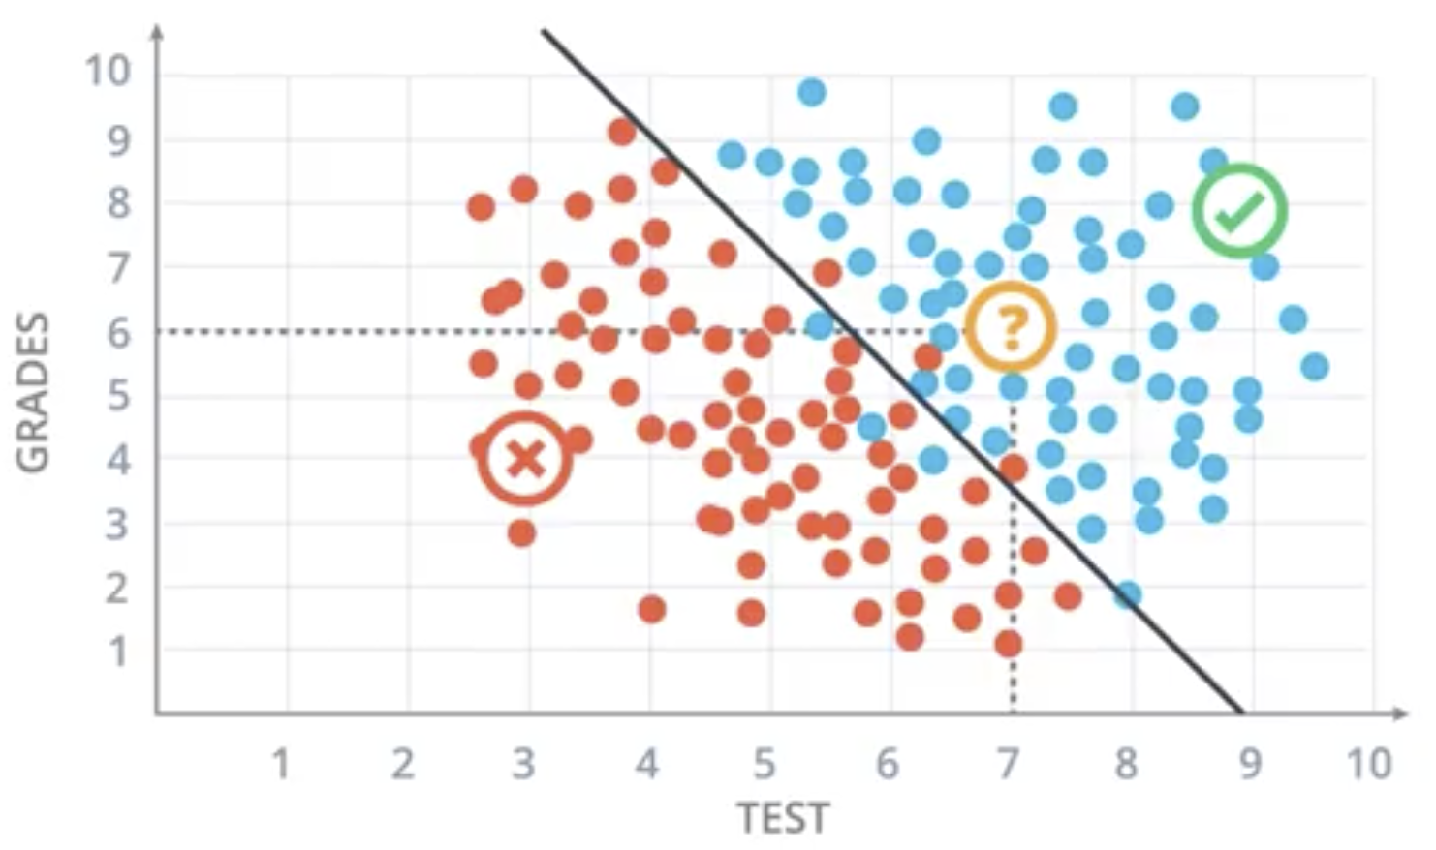
Decision boundary of Linear Perceptron
Ax + By + C = 0

Slide 21
Perceptron Training – idea
We start with a random line (by selecting random values of A, B, and C
We need to shift the decision boundary in such a way that it appropriately shifts the line

Slide 22
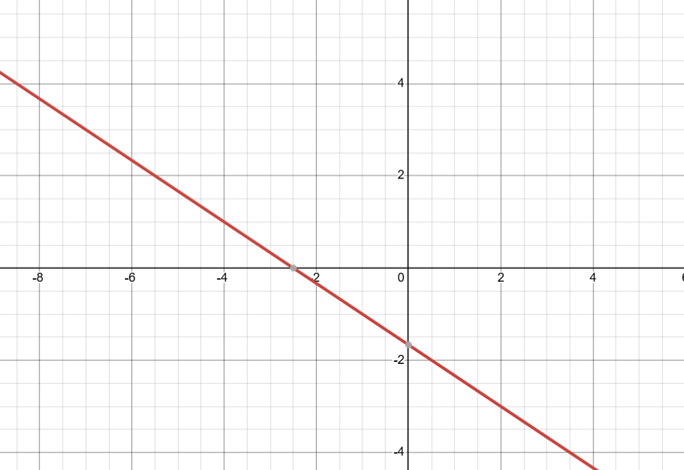
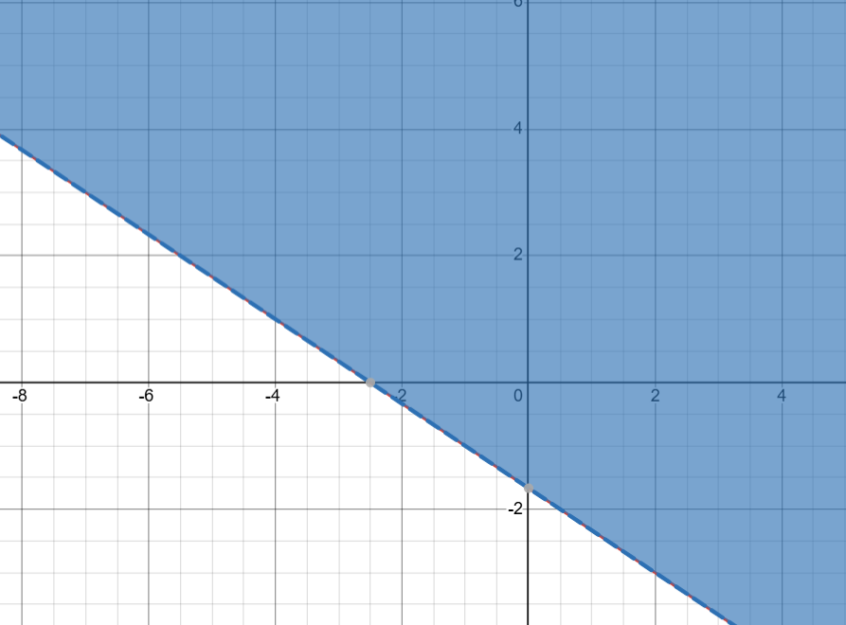
Perceptron Training – idea
2x + 3y + 5 = 0
2x + 3y + 5 > 0

Slide 23
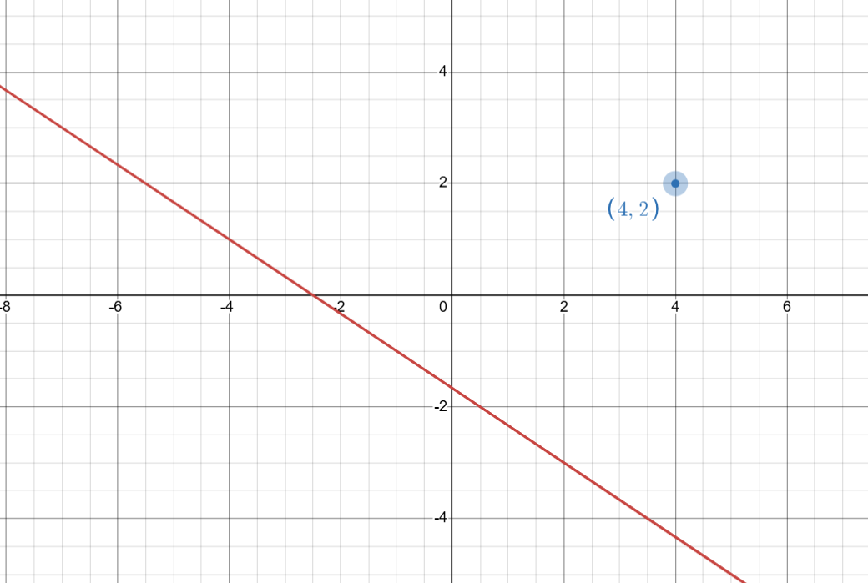
Perceptron Training – idea
Decision boundary: 2x + 3y + 5 = 0
Let us say we have a point, P (4,2) which belongs to a negative class i.e. it was wrongly predicted as a positive class.
We need to shift the decision boundary to the right of the point P.

Slide 24
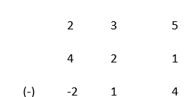
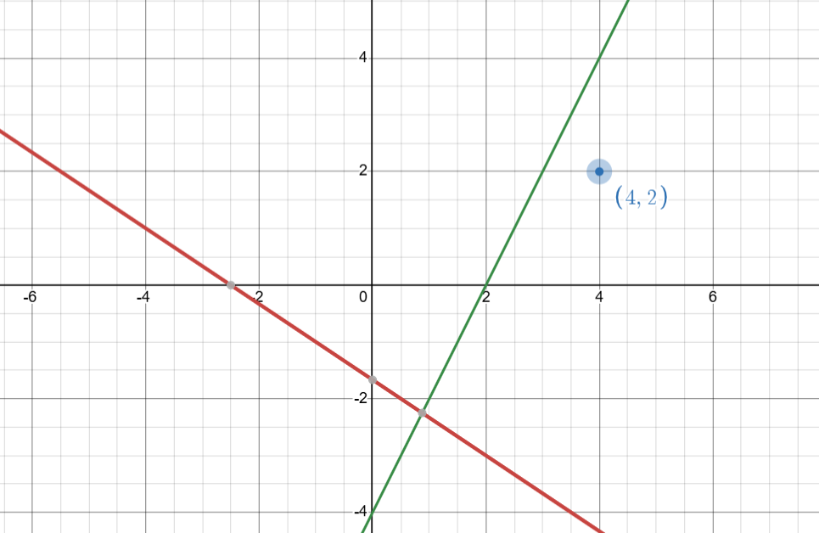
Perceptron Training – idea

Slide 25
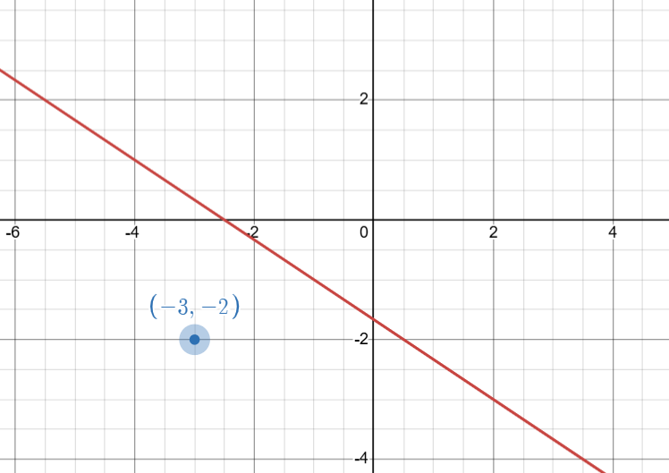
Perceptron Training – idea
Decision boundary: 2x + 3y + 5 = 0
Let us say we have a point, Q (-3,-2) which belongs to a positive class i.e. it was wrongly predicted as a negative class.
We need to shift the decision boundary to the right of the point P.

Slide 26
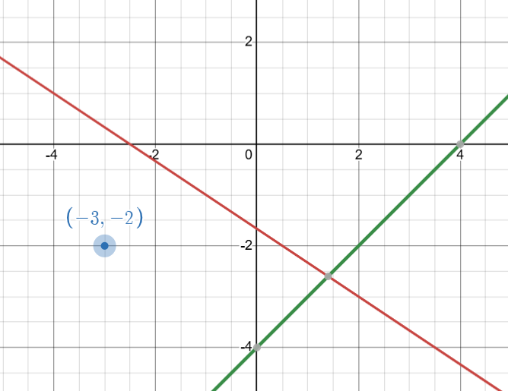
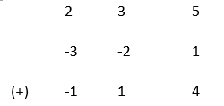
Perceptron Training – idea
Decision boundary: 2x + 3y + 5 = 0
Let us say we have a point, Q (-3,-2) which belongs to a positive class i.e. it was wrongly predicted as a negative class.
We need to shift the decision boundary to the right of the point P.

Slide 27
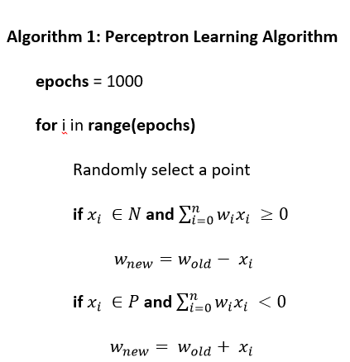
Learning Algorithm
The updates of the bias and weights are too abrupt.
In order to make the learning more gradual, we need to introduce a learning rate, η

Slide 28
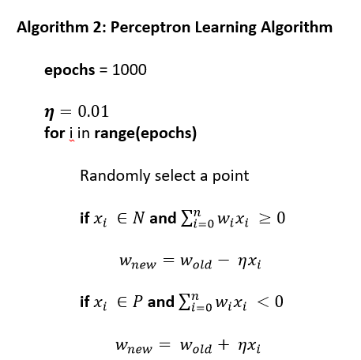
Learning Algorithm

Slide 29
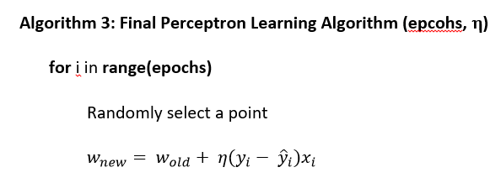
Learning Algorithm

Slide 30
Problems with Perceptron rule / Perceptron trick
Convergence can be slow
If the learning rate (η) is too small, updates take too long.
If η is too large, it may oscillate and never converge.
Limited generalization ability
The perceptron only finds one possible hyperplane, but there are often many valid solutions.
It does not optimize for the best margin, meaning it may not generalize well to new data.

Slide 31
Loss Function
A loss function is a mathematical function that measures how well a machine learning model’s predictions match the actual values. It quantifies the error between predicted outputs and the true labels, guiding the model’s learning process.

Slide 32
Why do we need a loss function?
It evaluates the model's performance by computing the difference between predictions and actual values.
It guides optimization algorithms (like gradient descent) to update the model’s parameters (weights & biases).
A smaller loss means a better model.

Slide 33
Examples of Loss Function
Hinge loss – SVM
Cross Entropy loss / Log loss – Logistic Regression
MSE – Regression
MAE – Regression
Huber Loss – Regression (less sensitive to outliers compared to MSE)

Slide 34
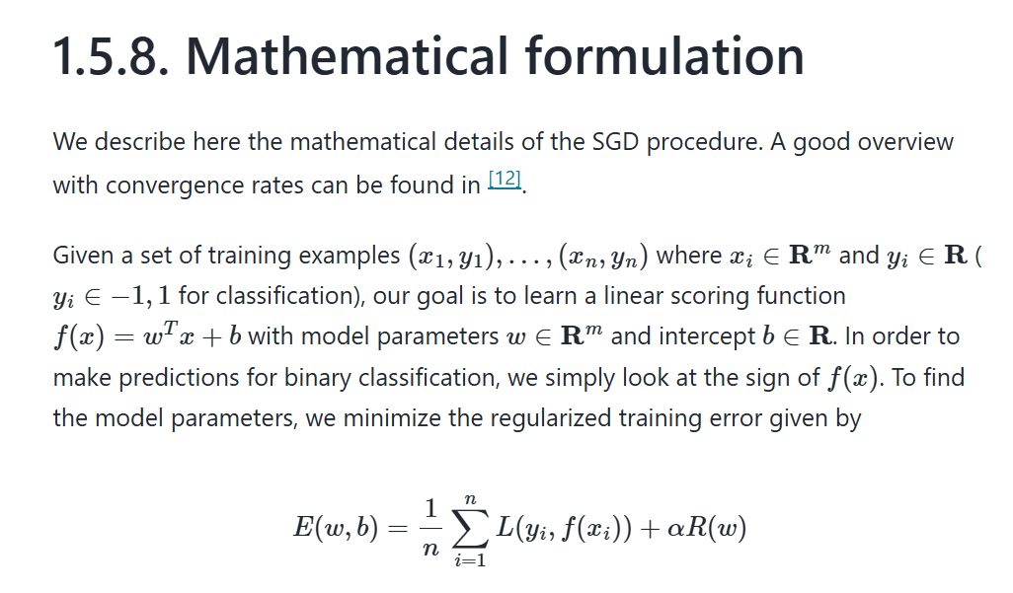
Loss Function (sklearn documentation)
https://scikit-learn.org/stable/modules/sgd.html#

Slide 35
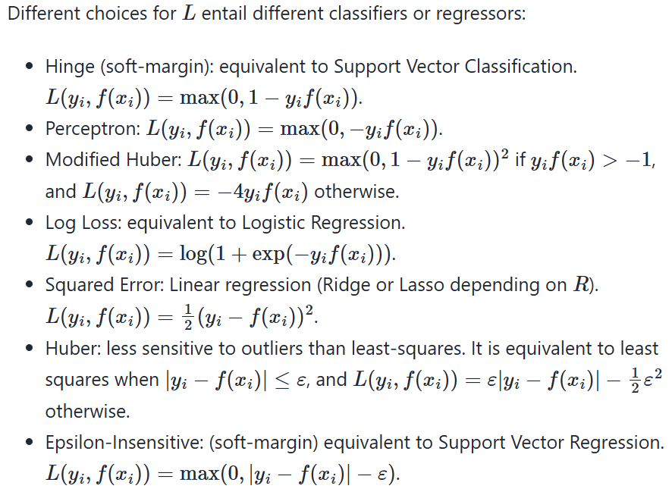
Loss Functions

Slide 36
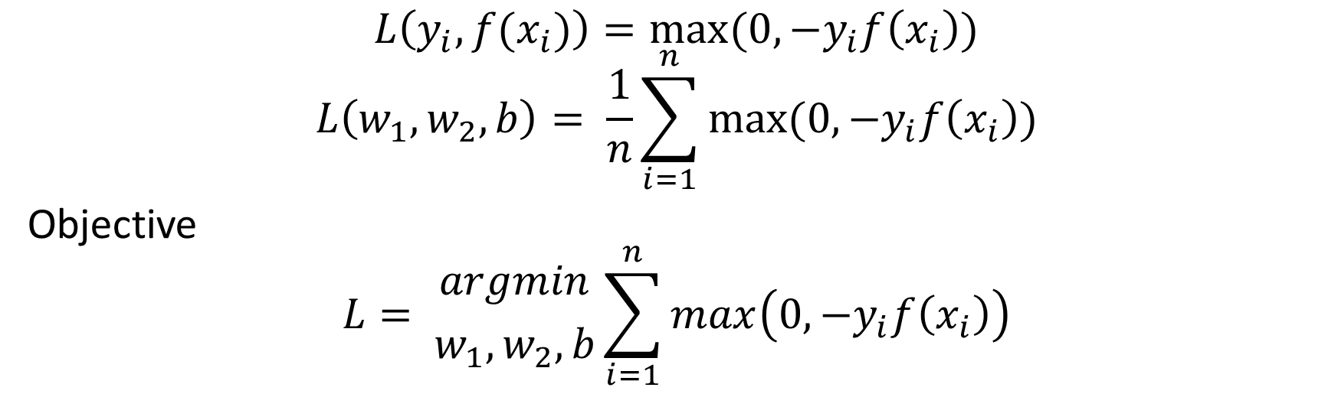
Perceptron Loss Function
$$L\left(y_{i}, f(x_{i})\right)=max(0, −y_{i}f\left(x_{i}\right))$$
$$L\left(w_{1}, w_{2}, b\right)= \frac{1}{n}\sum_{i=1}^{n}{max⁡(0, −y_{i}f\left(x_{i}\right))}$$
Objective
$$L= {argmin \atop w_{1}, w_{2}, b}\sum_{i=1}^{n}{max\left(0, −y_{i}f\left(x_{i}\right)\right)}$$
Gradient descent

Slide 37
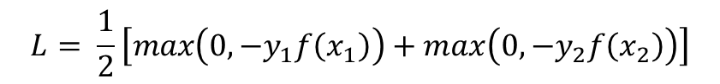
Understanding Perceptron Loss Function
1 | 2
X₁ | X₂ | Y
X₁₁ | X₂₁ | -1/1
X₂₁ | X₂₂ | -1/1
…
X_{i1} | X_{i2} | -1/1
… | … | …
X_{n1} | X_{n2} | -1/1
$$f\left(x_{i}\right)= w_{1}x_{i1}+w_{2}x_{i2}+b$$
For two points
$$L= \frac{1}{2}\left[max\left(0, −y_{1}f\left(x_{1}\right)\right)+max\left(0, −y_{2}f\left(x_{2}\right)\right)\right]$$

Slide 38
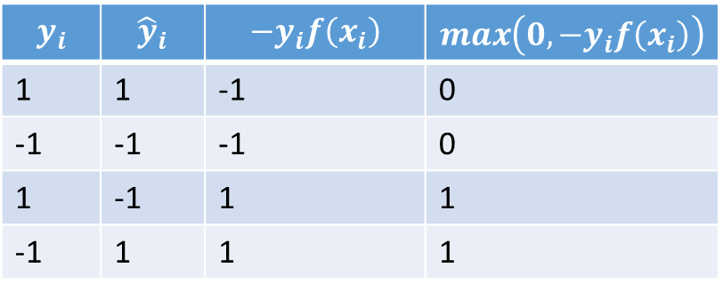
Understanding Perceptron Loss Function
$$y_{i}$$ | $${\hat{y}}_{i}$$ | $$−y_{i}f\left(x_{i}\right)$$ | $$max\left(0, −y_{i}f\left(x_{i}\right)\right)$$
1 | 1 | -1 | 0
-1 | -1 | -1 | 0
1 | -1 | 1 | 1
-1 | 1 | 1 | 1

